Slide 1
Classification
Ensemble Classifiers

Slide 2
Ensemble Classifiers

Slide 3
Ensemble Classifiers
Introduction & Motivation
Methods to create Ensemble
Bais Variance Decomposition
Construction of Ensemble Classifiers
Bagging
Boosting (Ada Boost)
Random Forests

Slide 4
Introduction & Motivation
Suppose that you are a patient with a set of symptoms
Instead of taking opinion of just one doctor (classifier), you decide to take opinion of a few doctors!
Is this a good idea? Indeed it is.
Consult many doctors and then based on their diagnosis; you can get a fairly accurate idea of the diagnosis.
Majority voting - ‘bagging’
More weightage to the opinion of some ‘good’ (accurate) doctors - ‘boosting’
In bagging, you give equal weightage to all classifiers, whereas in boosting you give weightage according to the accuracy of the classifier.

Slide 5
Ensemble Methods
Construct a set of classifiers from the training data
Predict class label of previously unseen records by aggregating predictions made by multiple classifiers

Slide 6
General Idea
Figure taken from Tan et. al. book “Introduction to Data Mining”

Slide 7
Rationale for Ensemble Methods
Statistical reasons
–A set of classifiers with similar training performances may have different generalization performances.
–Combining outputs of several classifiers reduces the risk of selecting a poorly performing classifier.
Large volumes of data
–If the amount of data to be analyzed is too large, a single classifier may not be able to handle it; train different classifiers on different partitions of data.
Too little data
–Ensemble systems can also be used when there is too little data; resampling techniques.

Slide 8
Rationale for Ensemble Methods

Slide 9
Why does it work?
Suppose there are 25 base classifiers
Each classifier has error rate, ε = 0.35
Assume classifiers are independent
Probability that the ensemble classifier makes a wrong prediction:
CHK out yourself if it is correct!!
Example taken from Tan et. al. book “Introduction to Data Mining”

Slide 11
Ensemble Classifiers (EC)
An ensemble classifier constructs a set of ‘base classifiers’ from the training data
Methods for constructing an EC
Manipulating training set
Manipulating input features
Manipulating class labels
Manipulating learning algorithms

Slide 12
Ensemble Classifiers (EC)
Manipulating training set
Multiple training sets are created by resampling the data according to some sampling distribution
Sampling distribution determines how likely it is that an example will be selected for training – may vary from one trial to another
Classifier is built from each training set using a particular learning algorithm
Examples: Bagging & Boosting

Slide 13
Ensemble Classifiers (EC)
Manipulating input features
Subset of input features chosen to form each training set
Subset can be chosen randomly or based on inputs given by Domain Experts
Good for data that has redundant features
Random Forest is an example which uses DT as its base classifiers

Slide 14
Ensemble Classifiers (EC)
Manipulating class labels
When no. of classes is sufficiently large
Training data is transformed into a binary class problem by randomly partitioning the class labels into 2 disjoint subsets, A0 & A1
Re-labelled examples are used to train a base classifier
By repeating the class labeling and model building steps several times, and ensemble of base classifiers is obtained
How a new tuple is classified?
Example – error correcting output coding (pp 307)

Slide 15
Ensemble Classifiers (EC)
Manipulating learning algorithm
Learning algorithms can be manipulated in such a way that applying the algorithm several times on the same training data may result in different models
Example – ANN can produce different models by changing network topology or the initial weights of links between neurons
Example – ensemble of DTs can be constructed by introducing randomness into the tree growing procedure – instead of choosing the best split attribute at each node, we randomly choose one of the top k attributes

Slide 16
Ensemble Classifiers (EC)
First 3 approaches are generic – can be applied to any classifier
Fourth approach depends on the type of classifier used
Base classifiers can be generated sequentially or in parallel

Slide 17
Typical Ensemble Procedure

Slide 18
Ensemble Classifiers
Ensemble methods work better with ‘unstable classifiers’
Classifiers that are sensitive to minor perturbations in the training set
Examples:
Decision trees
Rule-based
Artificial neural networks

Slide 19
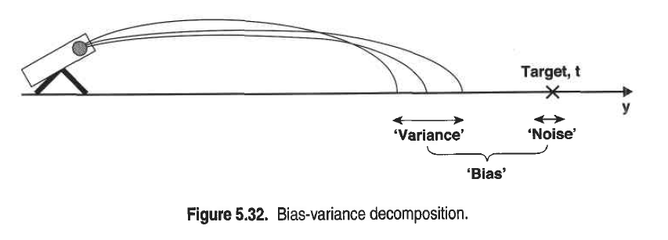
Bias-Variance Decomposition

Slide 20
Bias Vs Variance

Slide 21
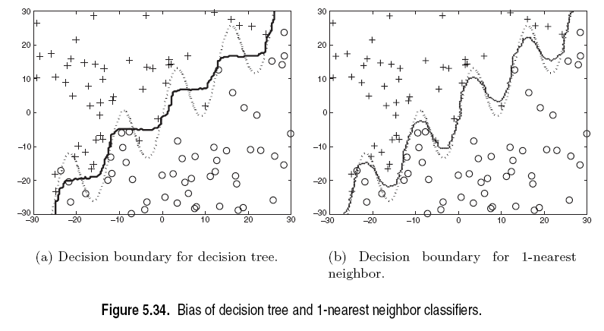
Bias: Example

Slide 22
Examples of Ensemble Methods
How to generate an ensemble of classifiers?
Bagging
Boosting
Random Forests

Slide 23
Bagging
Also known as bootstrap aggregation
Sampling uniformly with replacement
Build classifier on each bootstrap sample
0.632 bootstrap
Each bootstrap sample D_{i} contains approx. 63.2% of the original training data
Remaining (36.8%) are used as test set
Example taken from Tan et. al. book “Introduction to Data Mining”

Slide 25
Bagging: Boostrap Aggregation
Analogy: Diagnosis based on multiple doctors’ majority vote
Training
Given a set D of d tuples, at each iteration i, a training set D_{i} of d tuples is sampled with replacement from D (i.e., boostrap)
A classifier model M_{i} is learned for each training set D_{i}
Classification: classify an unknown sample X
Each classifier M_{i} returns its class prediction
The bagged classifier M* counts the votes and assigns the class with the most votes to X
Prediction: can be applied to the prediction of continuous values by taking the average value of each prediction for a given test tuple
Accuracy
Often significant better than a single classifier derived from D
For noise data: not considerably worse, more robust
Proved improved accuracy in prediction

Slide 26
Bagging
Accuracy of bagging:
Works well for small data sets
Example:
X | 0.1 | 0.2 | 0.3 | 0.4 | 0.5 | 0.6 | 0.7 | 0.8 | 0.9 | 1.0
y | 1 | 1 | 1 | -1 | -1 | -1 | -1 | 1 | 1 | 1
Actual Class labels
Example taken from Tan et. al. book “Introduction to Data Mining”

Slide 27
Bagging
Decision Stump
Single level decision binary tree
Entropy – x<=0.35 or x<=0.75
Accuracy at most 70%
Actual Class labels

Slide 28
Bagging
Accuracy of ensemble classifier: 100% ☺
Example taken from Tan et. al. book “Introduction to Data Mining”

Slide 29
Bagging- Final Points
Works well if the base classifiers are unstable
Increased accuracy because it reduces the variance of the individual classifier
Does not focus on any particular instance of the training data
Therefore, less susceptible to model over-fitting when applied to noisy data
What if we want to focus on a particular instances of training data?

Slide 30
Boosting
An iterative procedure to adaptively change distribution of training data by focusing more on previously misclassified records
Initially, all N records are assigned equal weights
Unlike bagging, weights may change at the end of a boosting round

Slide 31
Boosting: Motivation
Hard to design accurate classifier which generalizes well
• Easy to find many rule of thumb or weak classifiers
• a classifier is weak if it is slightly better than random guessing
• example: if an email has word “money” classify it as spam,
otherwise classify it as not spam
• likely to be better than random guessing
• Can we combine several weak classifiers to produce an
accurate classifier?
• • Ada‐Boost (1996) was the first practical boosting algorithm

Slide 32
Boosting
Records that are wrongly classified will have their weights increased
Records that are classified correctly will have their weights decreased
Example 4 is hard to classify
Its weight is increased, therefore it is more likely to be chosen again in subsequent rounds
Example taken from Tan et. al. book “Introduction to Data Mining”

Slide 33
Boosting
Equal weights are assigned to each training tuple (1/d for round 1)
After a classifier M_{i} is learned, the weights are adjusted to allow the subsequent classifier M_{i+1} to “pay more attention” to tuples that were misclassified by M_{i}.
Final boosted classifier M* combines the votes of each individual classifier
Weight of each classifier’s vote is a function of its accuracy
Adaboost – popular boosting algorithm

Slide 34
Adaboost
Input:
Training set D containing d tuples
k rounds
A classification learning scheme
Output:
A composite model

Slide 35
Adaboost
Data set D containing d class-labeled tuples (X1,y1), (X2,y2), (X3,y3),….(Xd,yd)
Initially assign equal weight 1/d to each tuple
To generate k base classifiers, we need k rounds or iterations
Round i, tuples from D are sampled with replacement , to form D_{i} (size d)
Each tuple’s chance of being selected depends on its weight

Slide 36
Adaboost
Base classifier M_{i}, is derived from training tuples of D_{i}
Error of M_{i} is tested using D_{i}
Weights of training tuples are adjusted depending on how they were classified
Correctly classified: Decrease weight
Incorrectly classified: Increase weight
Weight of a tuple indicates how hard it is to classify it (directly proportional)

Slide 37
Adaboost
Some classifiers may be better at classifying some “hard” tuples than others
We finally have a series of classifiers that complement each other!
Error rate of model M_{i}:
where err(X_{j}) is the misclassification error for X_{j}(=1)
If classifier error exceeds 0.5, we abandon it
Try again with a new D_{i} and a new M_{i} derived from it

Slide 38
Adaboost
error (Mi) affects how the weights of training tuples are updated
If a tuple is correctly classified in round i, its weight is multiplied by
Adjust weights of all correctly classified tuples
Now weights of all tuples (including the misclassified tuples) are normalized
Normalization factor =
Weight of a classifier M_{i}’s weight is

Slide 39
Adaboost
The lower a classifier error rate, the more accurate it is, and therefore, the higher its weight for voting should be
Weight of a classifier M_{i}’s vote is
For each class c, sum the weights of each classifier that assigned class c to X (unseen tuple)
The class with the highest sum is the WINNER!

Slide 40
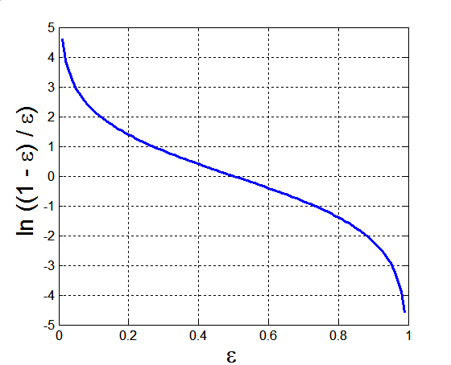
Example: AdaBoost
Base classifiers: C₁, C₂, …, C_{T}
Error rate:
Importance of a classifier:

Slide 41
Example: AdaBoost
Weight update:
If any intermediate rounds produce error rate higher than 50%, the weights are reverted back to 1/n and the re-sampling procedure is repeated

Slide 42
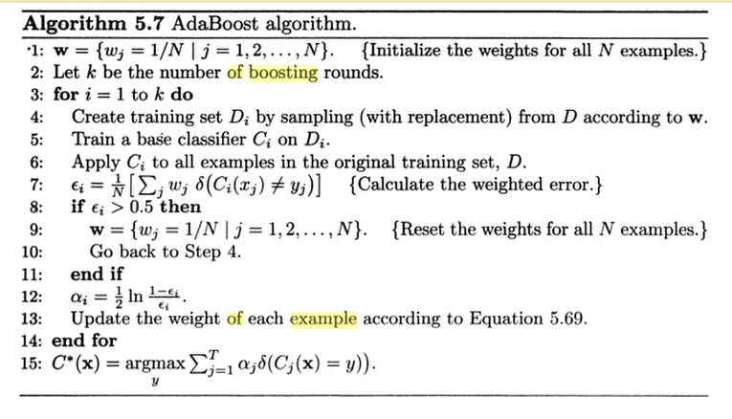

Slide 43
Illustrating AdaBoost
Initial weights for each data point
Data points for training

Slide 44
Illustrating AdaBoost

Slide 45
Example:
X | 0.1 | 0.2 | 0.3 | 0.4 | 0.5 | 0.6 | 0.7 | 0.8 | 0.9 | 1.0
y | 1 | 1 | 1 | -1 | -1 | -1 | -1 | 1 | 1 | 1
Actual Class labels
Example taken from Tan et. al. book “Introduction to Data Mining”

Slide 46
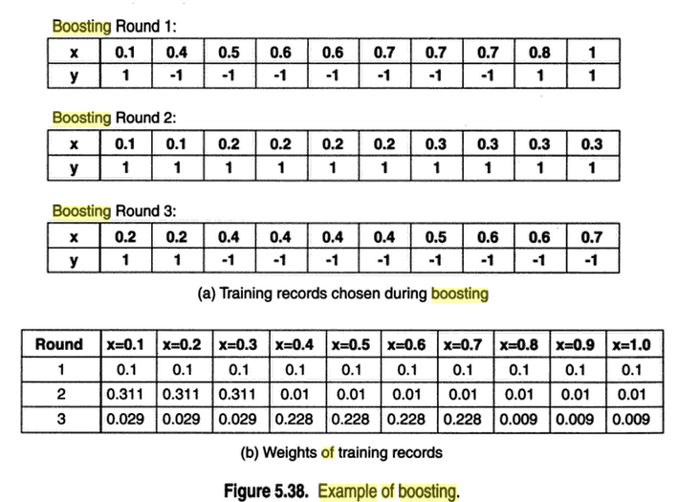

Slide 47
